Slide 1

Dimension Reduction

Slide 2
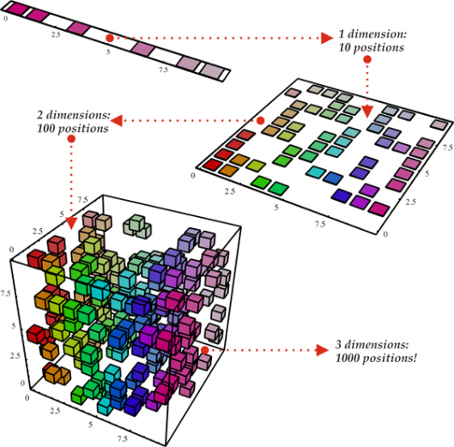
“The Curse of Dimensionality”
Number of samples required to cover the same percentage of sample space
Notes:
With a fixed number of training samples, the predictive power reduces as the dimensionality increases

Slide 3
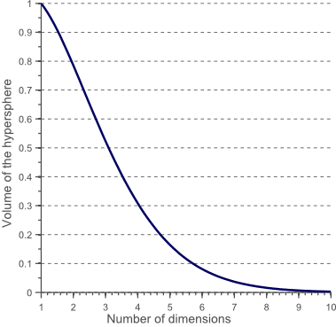
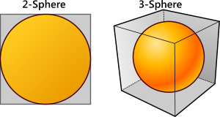
Ratio of sphere to enclosing cube in higher dimensions
The higher the dimension, the more “nothing” there is

Slide 4
Dimension Reduction
Compute representative samples and/or genes that express the essential information about the dataset in fewer dimensions.

Slide 5
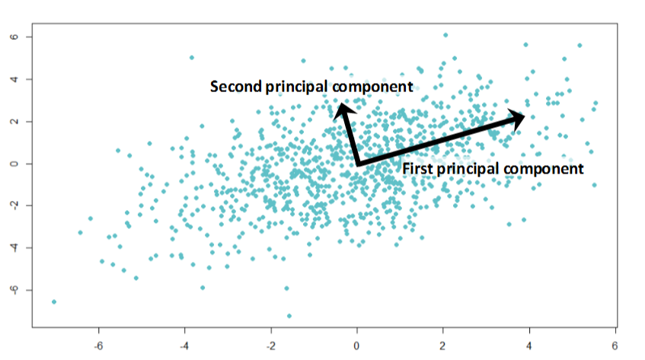
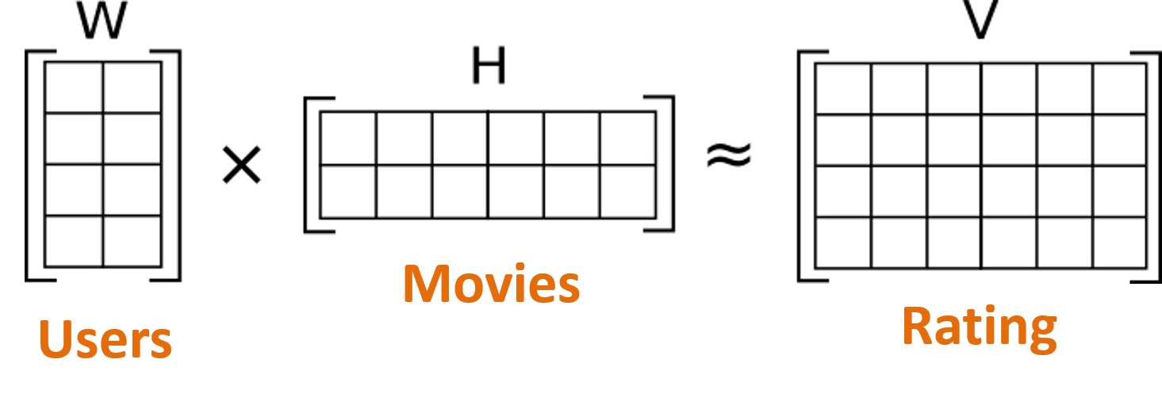
Dimension Reduction Methods
Principal Components Analysis (PCA)
Non-negative Matrix Factorization (NMF)

Slide 6
Principal Components Analysis (PCA)
Defines a set of “principal components”
1st PC: direction of greatest variability in data
2nd PC: perpendicular to 1st; greatest variability of remaining data
… so on until all dimensions are accounted for
The top principal components represent the data
Number of top PCs is much smaller than the total number of dimensions
Change coordinates of every data point to these dimensions

Slide 7
Exercise
2018-03-14-09_CCMI_Principal Components Analysis

